Slide 1



MLP for classify IRIS dataset
Professor R. Ghaderi
Seyed Mohammad Sajadi

Slide 2

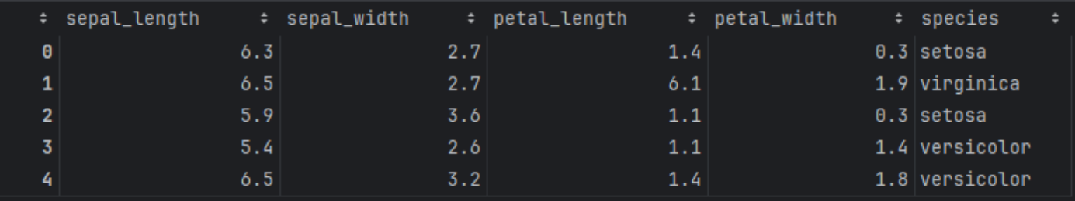
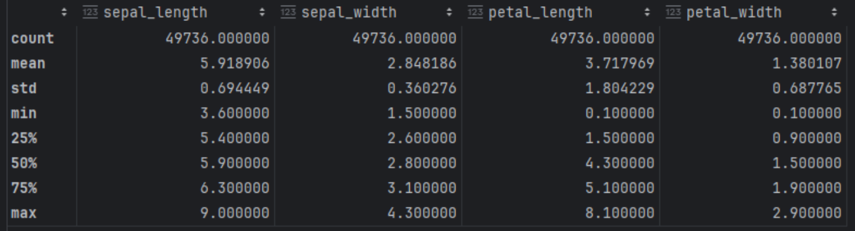
Data review

Slide 3

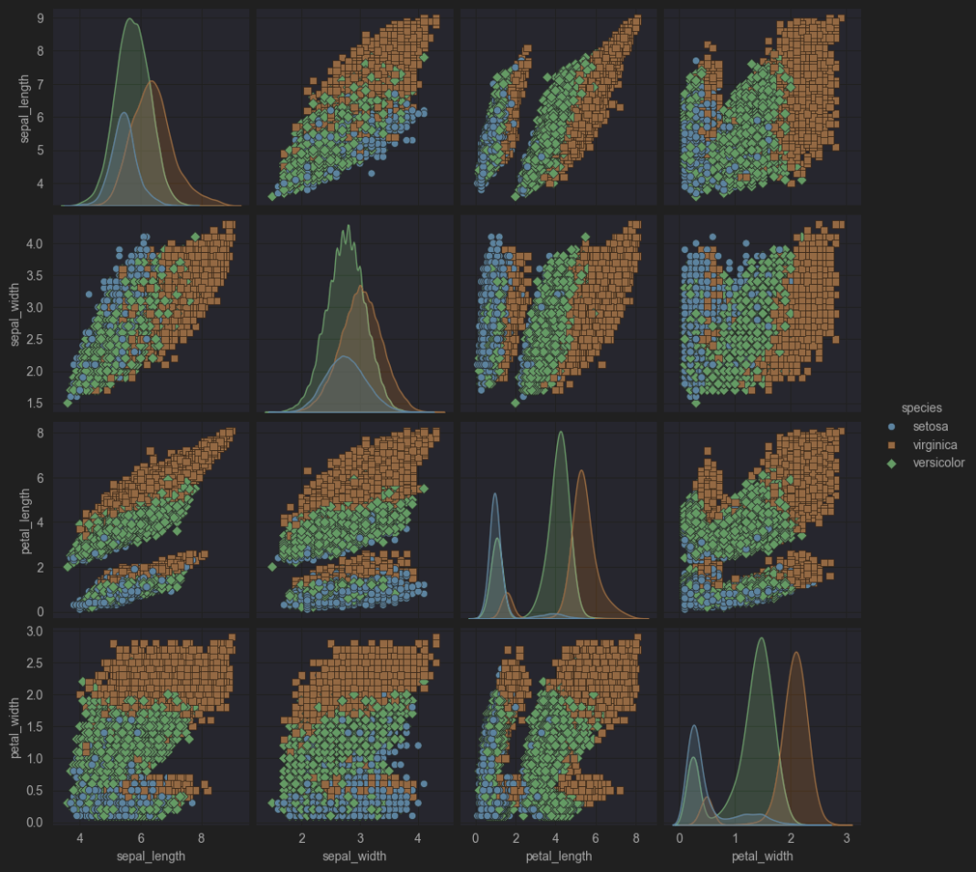

Slide 4

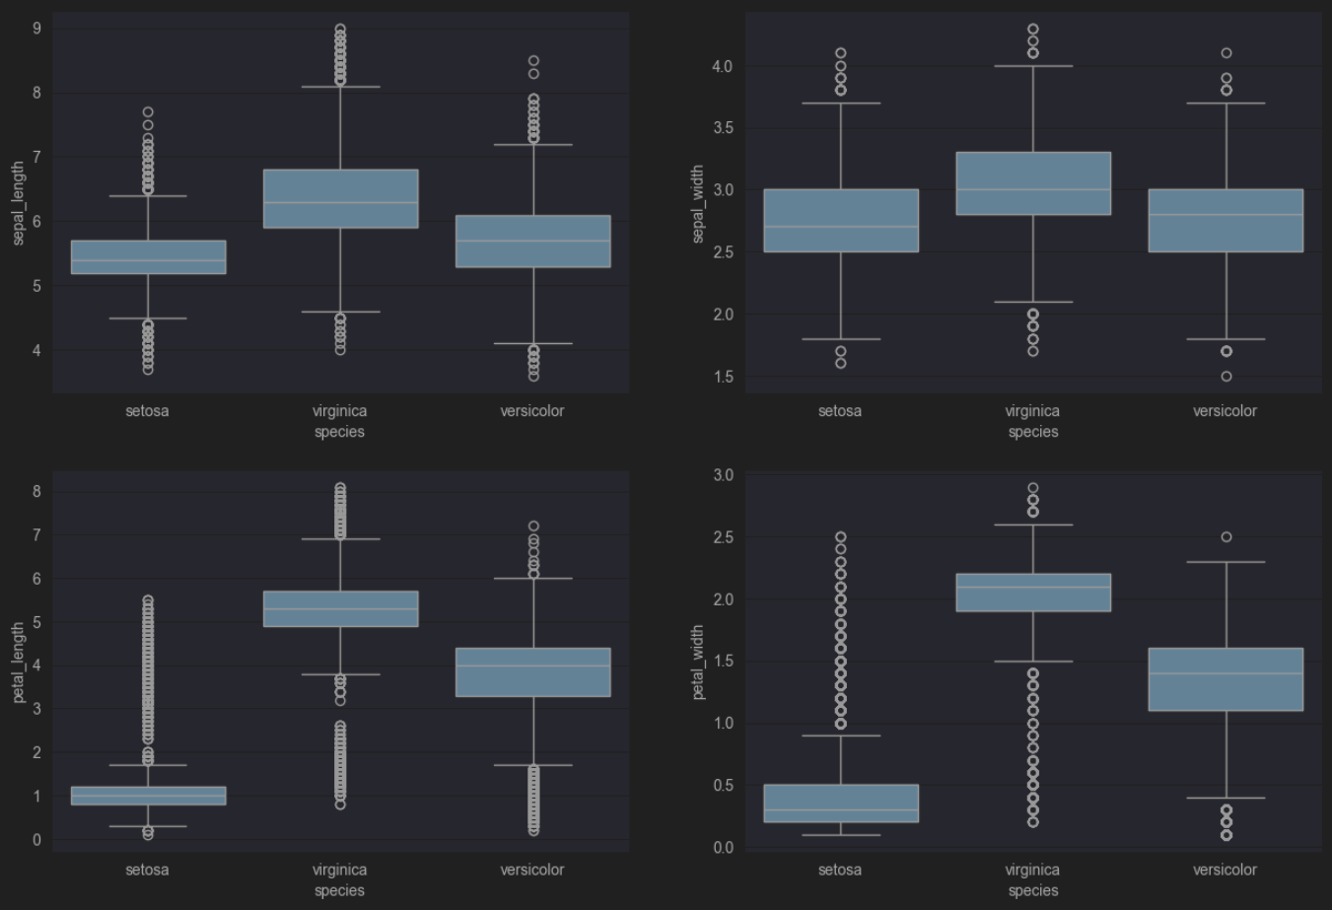

Slide 5
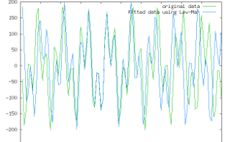
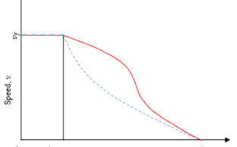
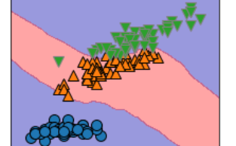
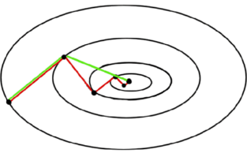
Training methods for iris dataset
Levenberg Marquardt
Speed Density Backpropagation
K-Neighbors Classifier
Powell-Beale-CG

Slide 6

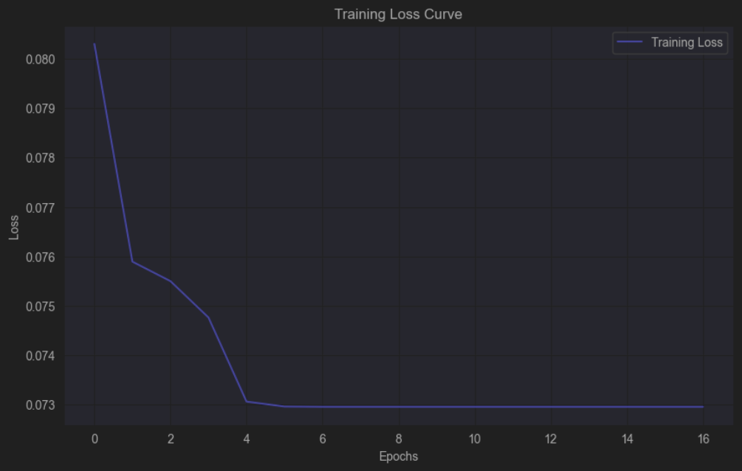
Levenberg Marquardt
Number of iterations
5 (For specific accuracy 17)
Accuracy
0.9667

Slide 7

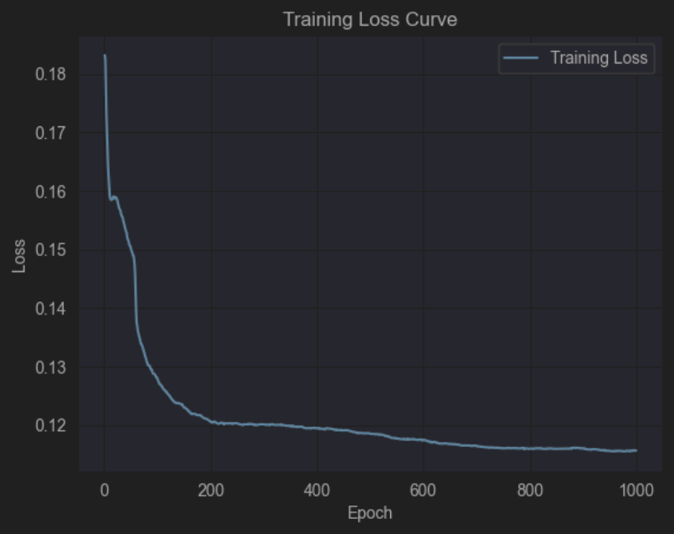
Speed Density Backpropagation
Number of iterations
1000
Accuracy
0.8798

Slide 8

K-Neighbors Classifier
Number of iterations
700
Accuracy
0.8795
Input Layer
4
Hidden Layer
5
Output Layer
3
Learning Rate
0.005
Activation Function
sigmoid

Slide 9

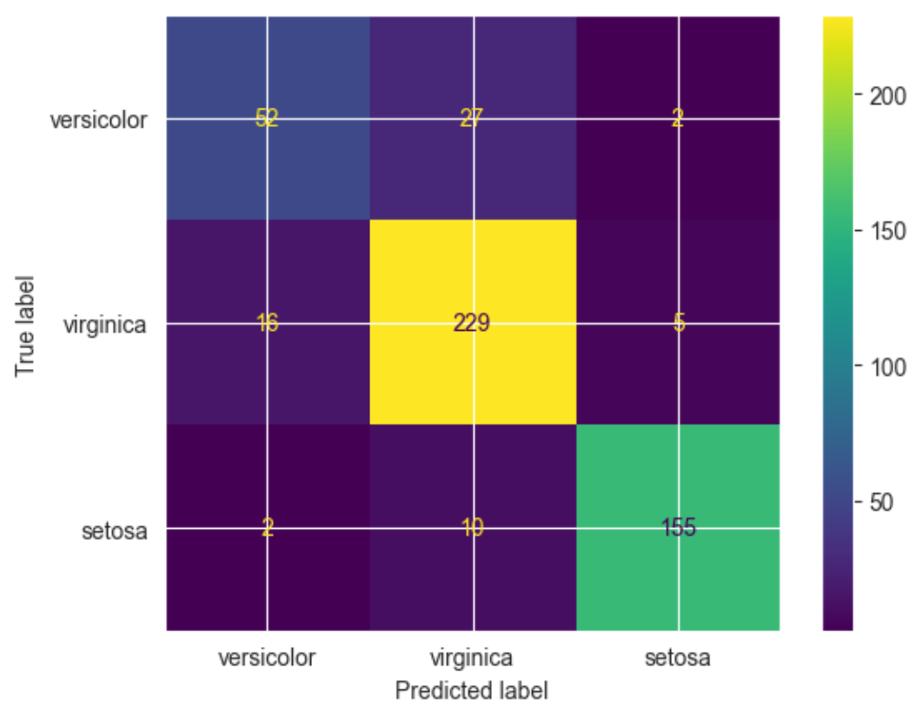
K-Neighbors Classifier

Slide 10
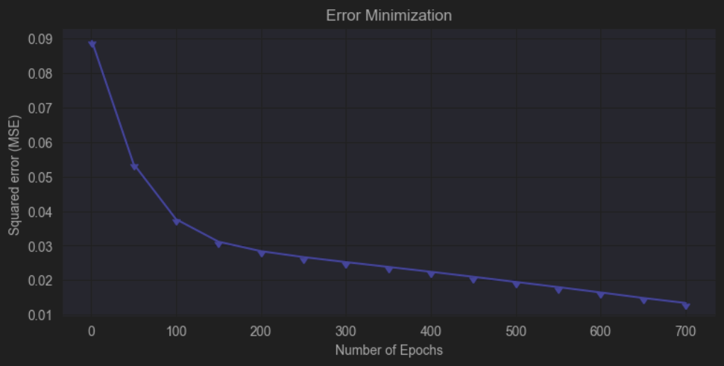
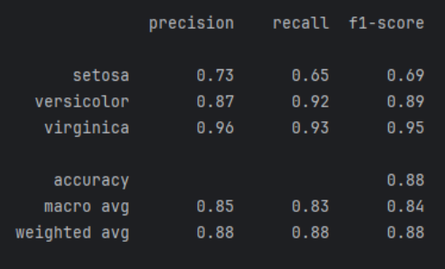
K-Neighbors Classifier

Slide 11

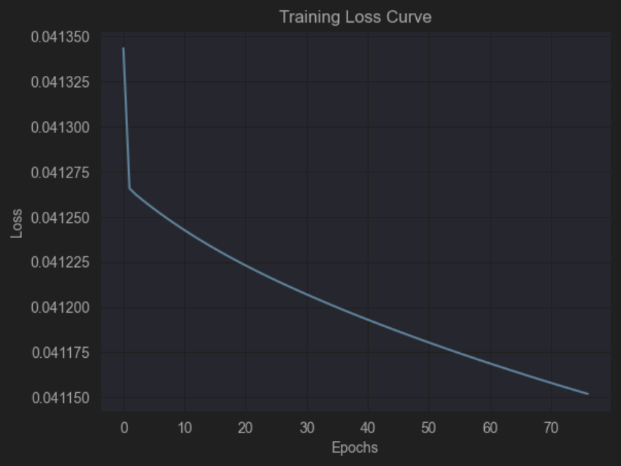
Powell-Beale-CG
Number of iterations
76
Accuracy
0.8267

Slide 12

Summarize the results of neural networks
1
Levenberg Marquardt
Number of iterations : 17
Accuracy : 96.67 %
2
Speed Density Backpropagation
Number of iterations : 1000
Accuracy : 87.98 %
3
K-Neighbors Classifier
Number of iterations : 700
Accuracy : 87.95 %
4
Powell-Beale-CG
Number of iterations : 76
Accuracy : 82.67 %

Slide 13

Thank for your patience

